Slide 1

Anomaly Detection in Cloud Server Logs Using Basic Text Mining
VARSHITHA YANAMALA
DATA 603 - PLATFORMS FOR BIG DATA PROCESSING
UNIVERSITY OF MARYLAND, BALTIMORE COUNTY
PROF. NAJAM HASSAN

Slide 2
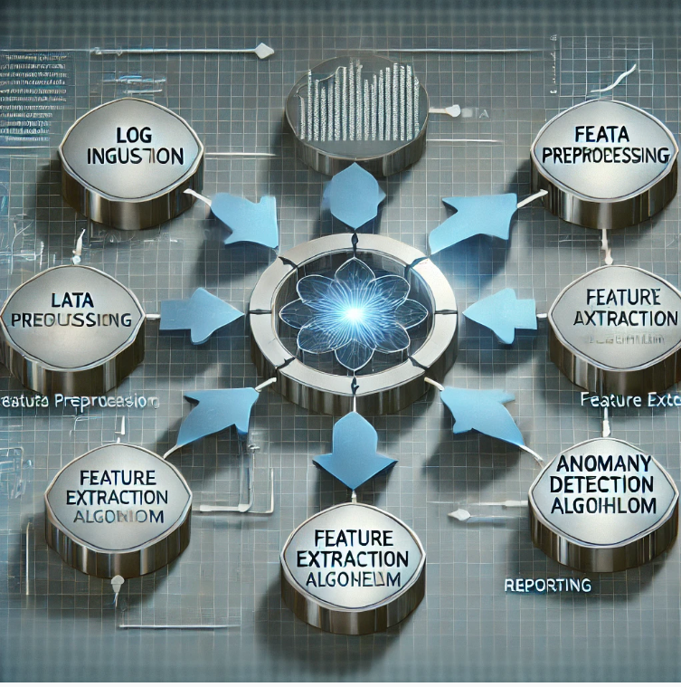


INTRODUCTION
THESIS
ARGUMENTS
SCOPE
Covers preprocessing, algorithms, challenges, and societal impacts of text mining in cloud log anomaly detection.
Basic text mining techniques efficiently detect anomalies in cloud server logs, enhancing system monitoring and mitigating risks.
Traditional methods are inadequate for modern cloud environments.
Text mining combined with machine learning is scalable and adaptable.

Slide 3

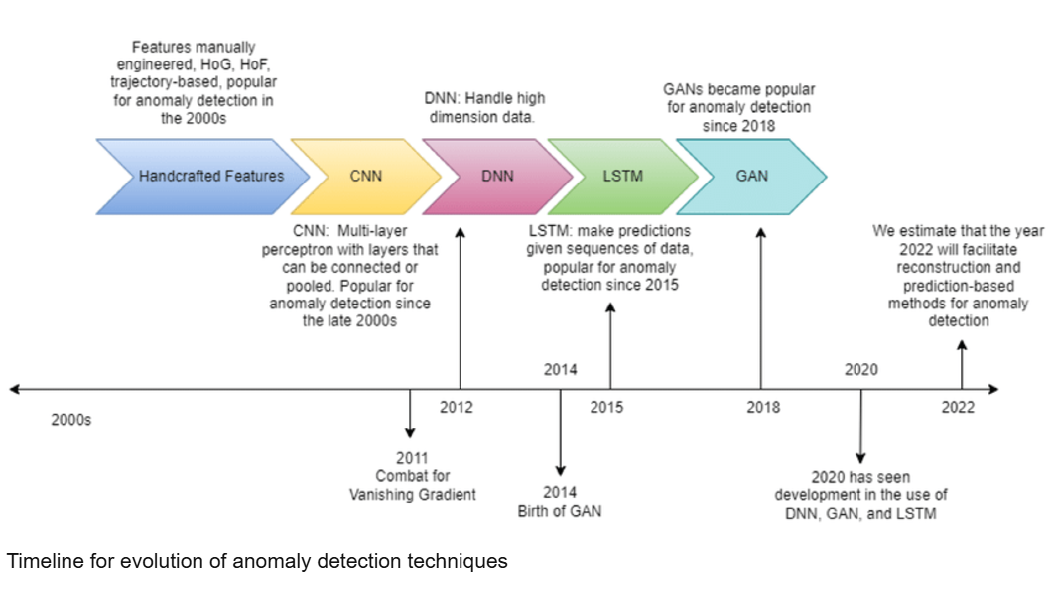

LITERATURE REVIEW
Origins
Evolution
Early anomaly detection relied on rule-based systems and statistical methods.
Deep learning: Captures complex patterns (Le & Zhang, 2022).
Automated systems: Real-time anomaly detection (Vervaet, 2023).
Unsupervised methods: Sequential and quantitative anomalies (Meng et al., 2022).
Trends:
Emphasis on scalable, explainable AI models (Alzoubi et al., 2024).

Slide 4


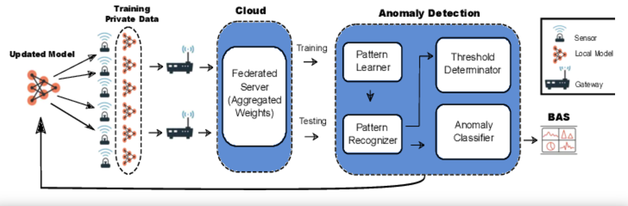
TECHNICAL DETAILS
Protocols & Standards:
Algorithms:
INNOVATIONS:
Autoencoders, One-Class SVM.
LSTMs for sequential anomalies.
Federated learning for privacy-preserving detection.
Common Event Format (CEF), syslog for consistency.
Preprocessing
Stop-word removal, tokenization, TF-IDF.

Slide 5


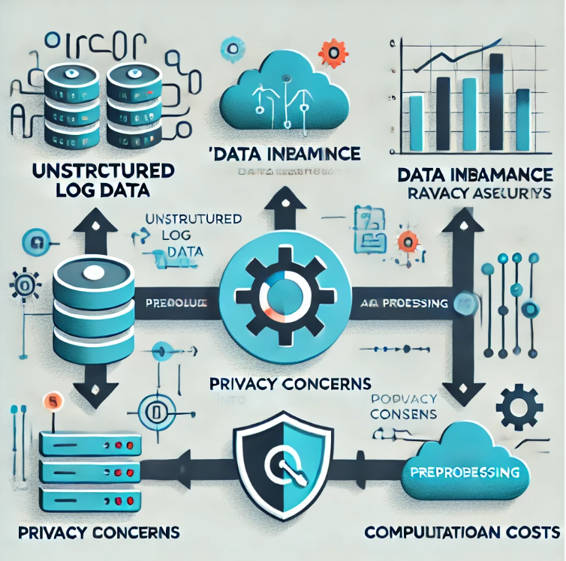
OBSTACLES
1
DAILY CHALLENGES
Data Challenges:
Unstructured logs require extensive preprocessing.
Dataset imbalance complicates rare event detection.
2
PRIVACY CONCERNS
Sensitive data demands robust privacy techniques like federated learning.
3
COMPUTATIONAL COSTS:
Real-time detection is resource-intensive.
4
EXPLAINABILITY
Black-box models hinder stakeholder trust.

Slide 6


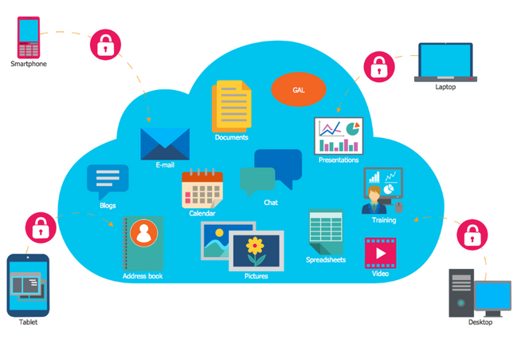
THE PROMISE
SECURITY ENHANCEMENTS
02
Applications:
01
Healthcare: Protects sensitive patient data.
Industry: Minimizes downtime, boosts productivity.
Faster threat detection reduces breaches
03
SOCIETAL IMPACT
Improves trust in cloud services with privacy-preserving approaches.

Slide 7

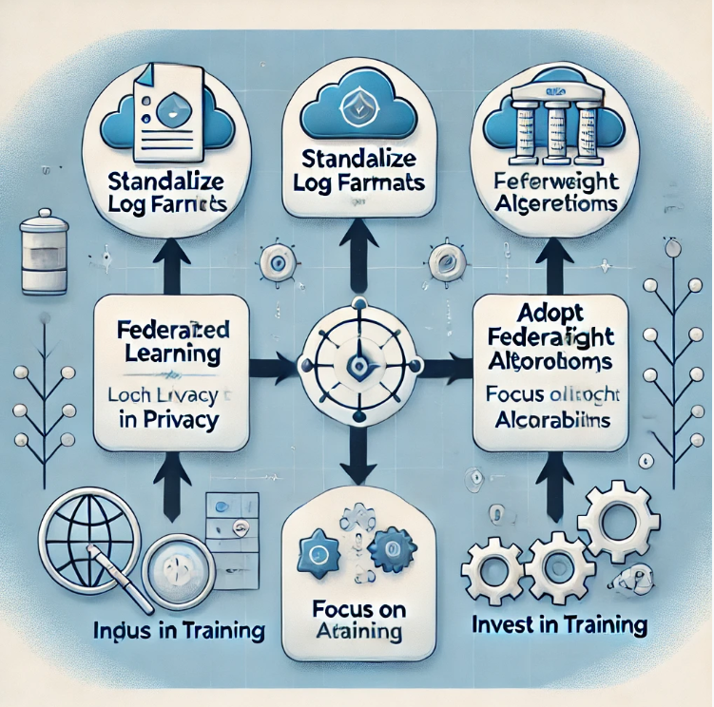

Suggested Course of Action
1
Standardize Log Formats
Simplify preprocessing and integration.
2
Adopt Federated Learning
Enhance privacy without compromising detection accuracy.
3
Focus on Lightweight Algorithms:
Enable real-time scalability.
INVEST IN TRAINING
4
Equip IT staff with advanced techniques.

Slide 8


CONCLUSION
KEY TAKEAWAYS
Basic text mining techniques effectively detect anomalies in cloud logs.
Addressing challenges like data imbalance, privacy, and explainability is critical.
Collaboration between academia and industry can drive innovative solutions.
VISION
Secure, reliable, and trustworthy cloud systems.

Slide 9



REFERENCES
Le, V.-H., & Zhang, H. (2022). Log-Based Anomaly Detection with Deep Learning: How Far Are We? International Conference on Software Engineering (ICSE).
Vervaet, A. (2023). MoniLog: An Automated Log-Based Anomaly Detection System for Cloud Computing Infrastructures. Institut Supérieur d’Électronique de Paris.
Meng, W., Liu, Y., Zhu, Y., Zhang, S., Pei, D., & Liu, Y. (2022). LogAnomaly: Unsupervised Detection of Sequential and Quantitative Anomalies in Unstructured Logs. Proceedings of the International Joint Conference on Artificial Intelligence.
Goldstein, M., & Uchida, S. (2016). A Comparative Evaluation of Unsupervised Anomaly Detection Algorithms for Multivariate Data. PLOS ONE, 11(4), e0152173. https://doi.org/10.1371/journal.pone.0152173
Yasarathna, T. L., & Munasinghe, L. (2020). Anomaly Detection in Cloud Network Data. Smart Computing and Systems Engineering. University of Kelaniya, Sri Lanka.

Slide 10
Luo, Z., He, K., & Yu, Z. (2021). A Robust Unsupervised Anomaly Detection Framework. Applied Intelligence, 52, 6022–6036
Alzoubi, Y. I., Mishra, A., & Topcu, A. E. (2024). Research Trends in Deep Learning and Machine Learning for Cloud Computing Security. Artificial Intelligence Review, 57, 132.
Zhang, B., Zhang, H., & Moscato, P. (2020). Anomaly Detection via Mining Numerical Workflow Relations from Logs. IEEE Symposium on Reliable Distributed Systems (SRDS).
Jayaweera, M. P. G. K., Kithulwatta, W. M. C. J. T., & Rathnayaka, R. M. K. T. (2023). Detect Anomalies in Cloud Platforms by Using Network Data: A Review. Cluster Computing, 26, 3279– 3289.
Shahzad, F., Mannan, A., Javed, A. R., Almadhor, A. S., Baker, T., & Al-Jumeily, D. (2022). CloudBased Multiclass Anomaly Detection and Categorization Using Ensemble Learning. Journal of Cloud Computing, 11(74).

Slide 11

THANK YOU

